Slide 1
OVERDOSE IS CLOSER THAN YOU THINK
Opioids in Alaska

Slide 2
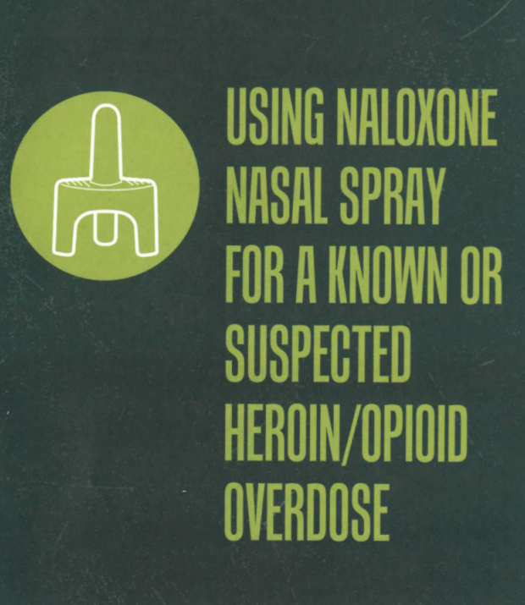

Slide 3
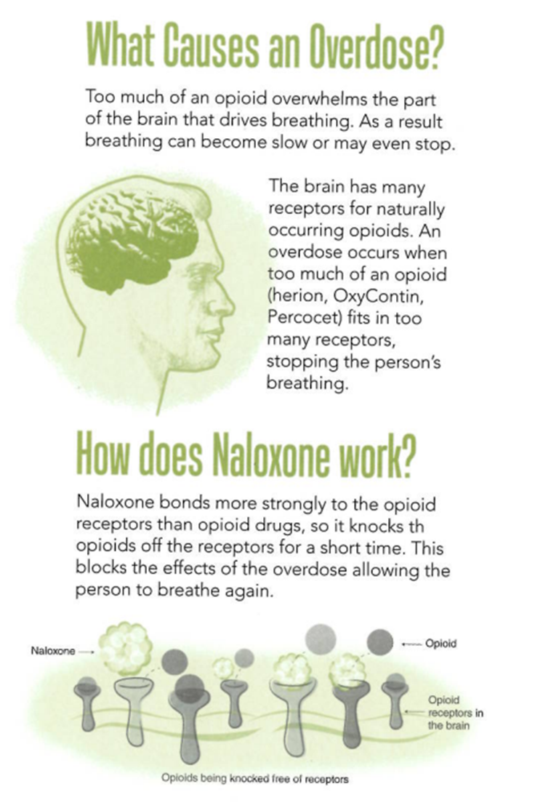

Slide 4
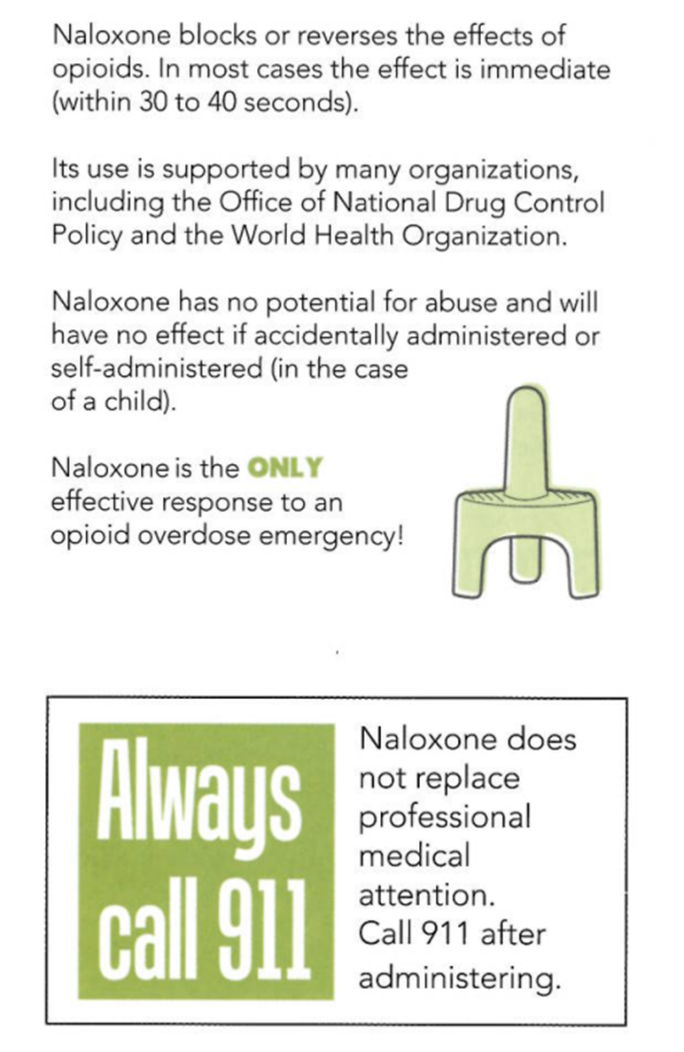

Slide 6
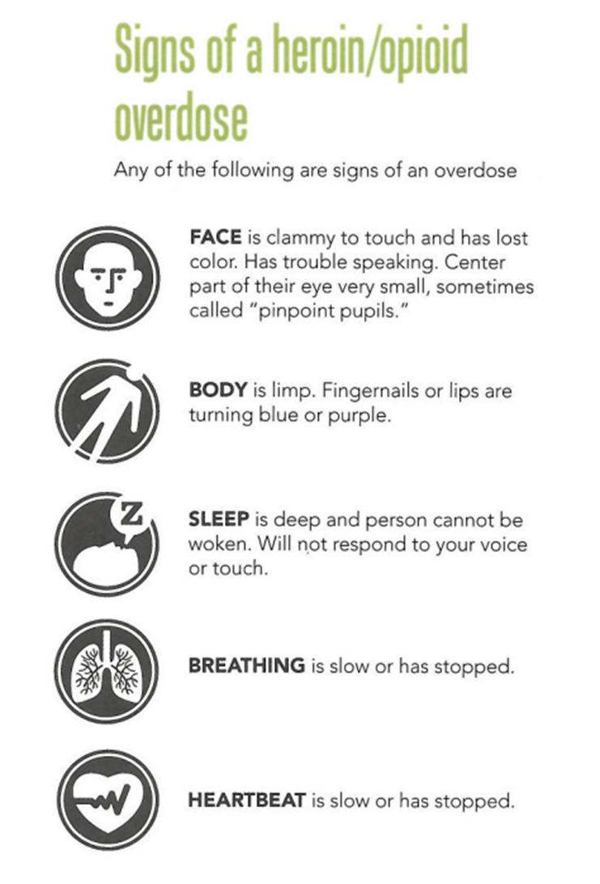

Slide 7
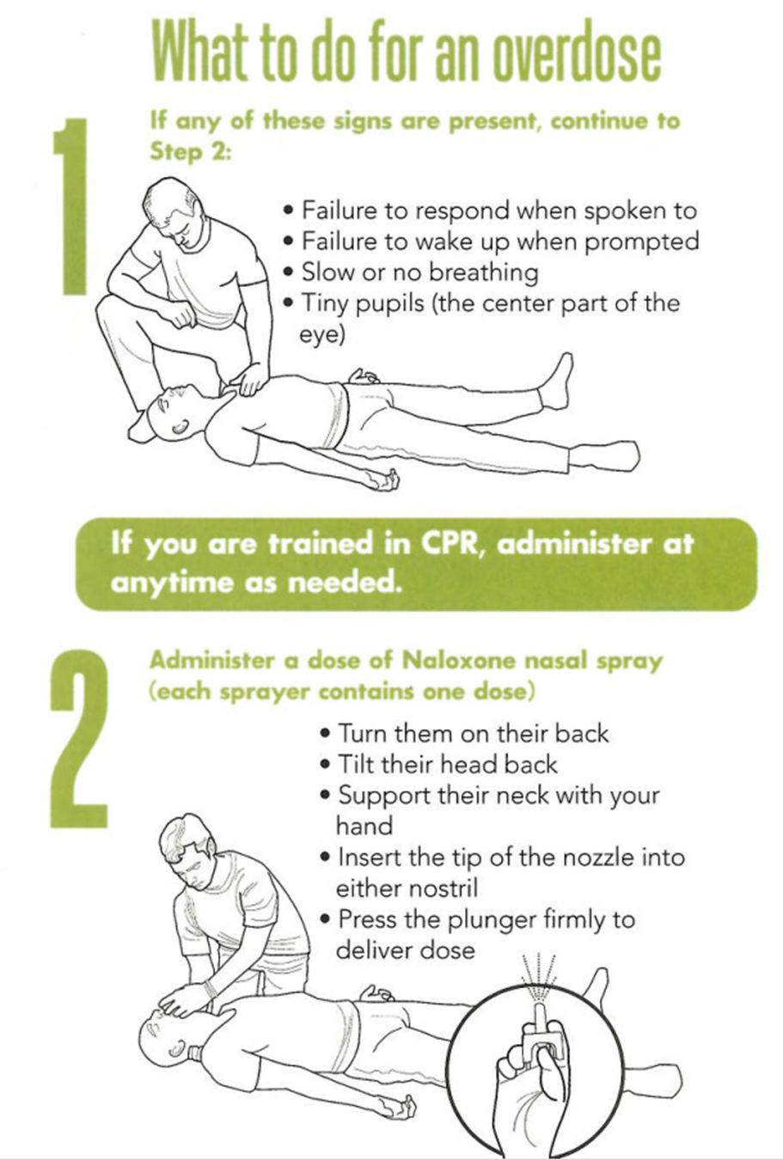

Slide 8
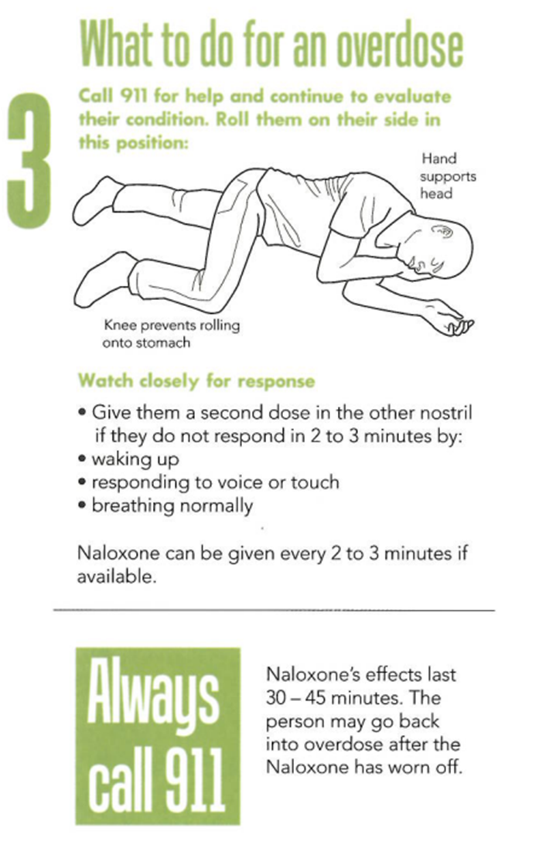

Slide 9
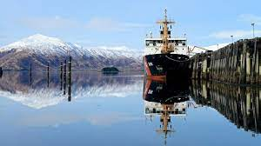
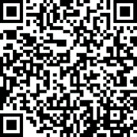
Would you like more information?
ProjectGABE@alaska.gov
ProjectGABE@alaska.gov
Notes:
Questions?
call your local Public Health Nurse or reach out to Project Gabe at: ProjectGABE@alaska.gov

